Slide 1
8th Grade English /Language Arts – Mr. Hopkins
Yesterday Handouts 1. Parts of Speech Worksheet Homework 1. Summer Reading Assessment 2. Parts of Speech Worksheet Due 1. None | August 24, 2018 (Friday) 1. Bell Ringer 2. Summer Reading Assessment My Email: dhopkins@d88a.org
 | Today’s Homework 1. Summer Reading Assessment 2. Parts of Speech Worksheet
Unit 1: Summer Reading
Daily Assignments/Moments | Assessments
1. Parts of Speech Pre-Test – 10pts
All documents and assignments will be loaded onto my class page

Slide 2
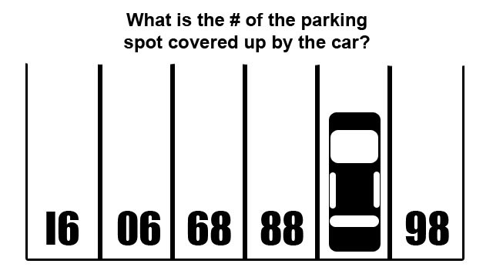
Bell Ringer
- Brain Teaser

Slide 3
Bell Ringer
- Brain Teaser

Slide 4
The Big Seven
What does this character want?
What does this character need?
How do these wants and needs conflict within the character?
How do the wants and needs conflict with the outside world?
How do the wants and needs conflict with the other characters?
How does the character change through those conflicts and how does the resolution of those conflicts affect the character?
What impact does that change have on everyone else?

Slide 5
Character Development

Slide 6
The Character Arc
Main characters will start the story with a certain viewpoint.
This viewpoint will be affected by the events of the story and the main conflict.
Main characters learn to adapt to the challenges in the story by confronting conflicts.
By the end of the story, the character’s viewpoint has changed in a significant way.

Slide 7
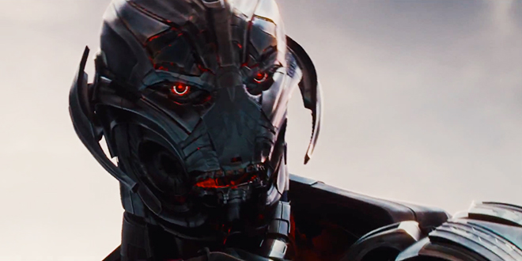
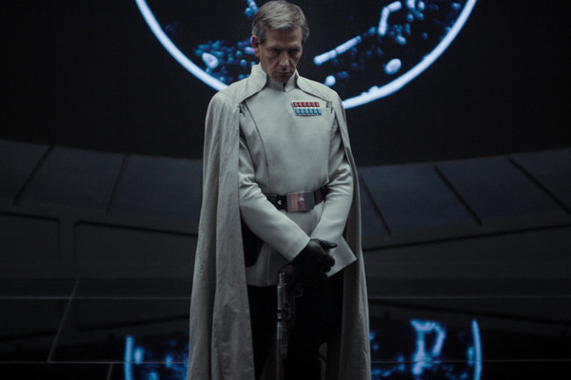
Types of Characters
Flat vs. Round
Flat
Two Dimensional
Relatively Uncomplicated
They lack the development of other characters
The reader really only knows one side of the character.
Examples
Krennic (Rogue One)
Nearly Every Marvel Movie
Villain

Slide 8
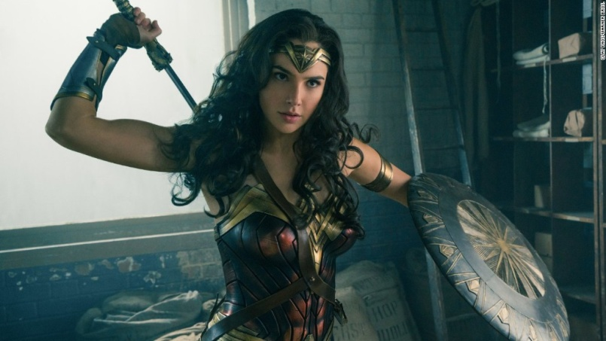
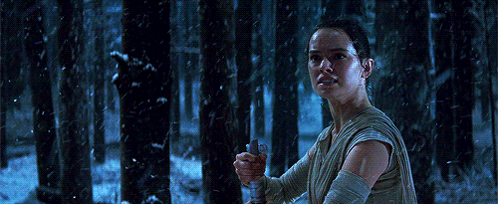
Types of Characters
Round
Complex characters
Many different characteristics
Undergo sufficient development
Significant changes in view from beginning to end.
Fully developed – Feels “real”
Examples
Wonder Woman
Captain America
Rey

Slide 9
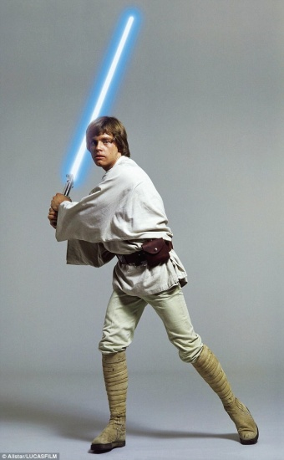
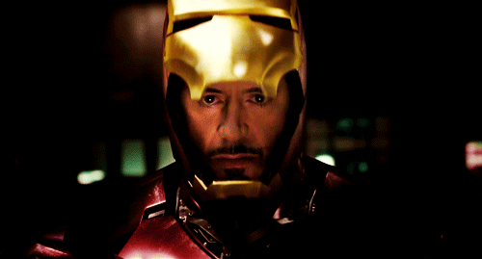
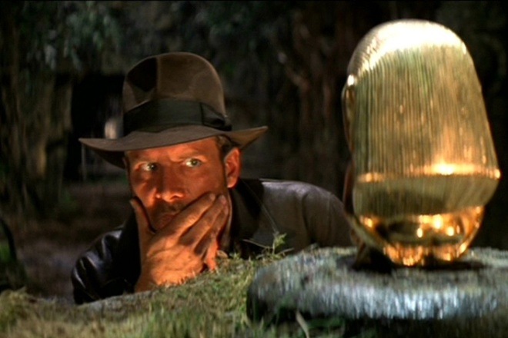
Types of Character Changes
Dynamic vs. Static
Dynamic
Experiences a permanent change based on events in the story.
The character completes an arc. They start one way and end up significantly different by the end.
Examples
Tony Stark
Luke Skywalker
Indiana Jones

Slide 10
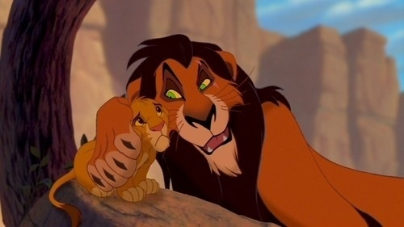
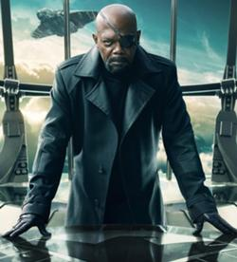
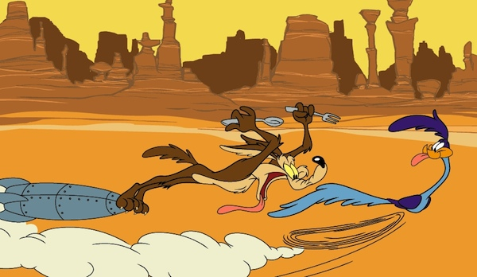
Types of Character Changes
Static
Static characters experience a minimal change or no change at all over the course of the story.
The character is consistent throughout the story.
Examples
Nick Fury
Scar
Road Runner and Wile E. Coyote

Slide 11
Characterization

Slide 12
Characterization
When an author/playwright gives their characters identifiable qualities that is called characterization.
This is the process by which the writer reveals the personality of a character.
This can be done directly and indirectly.

Slide 13
Characterization
Direct Characterization tells the audience what the personality of the character is.
“Scrooge! a squeezing, wrenching, grasping, scraping, clutching, covetous, old sinner!...” (665)

Slide 14
Characterization
Indirect Characterization shows things that reveal the personality of the character.
NEPHEW: [Cheerfully: surprising Scrooge] A Merry Christmas to you, Uncle! God save you!
SCROOGE: Bah! Humbug! (667)

Slide 15
Indirect Characterization
Five types of indirect characterization. (STEAL)
Speech – What does the character say? How do they speak?
Thoughts – What is revealed through the character’s private thoughts? (Monologue)
Effect – What is revealed through the character’s effect on other people? How do other characters react?
Actions – What does the character do? How does the character behave?
Looks – What does the character look like? How do they dress?

