Slide 1
8th Grade English /Language Arts – Mr. Hopkins
Friday Handouts 1. None Homework 1. Bring Summer Reading Book Due Syllabus Sign-Off | August 20, 2018 (Monday) 1. Bell Ringer 2. Parts of Speech – Pre-Test – Google Classroom My Email: dhopkins@d88a.org
 | Today’s Homework 1. Bring Summer Reading Book - Tomorrow
Unit 1: Parts of Speech Review
Daily Assignments/Moments | Assessments
1.
All documents and assignments will be loaded onto my class page

Slide 2
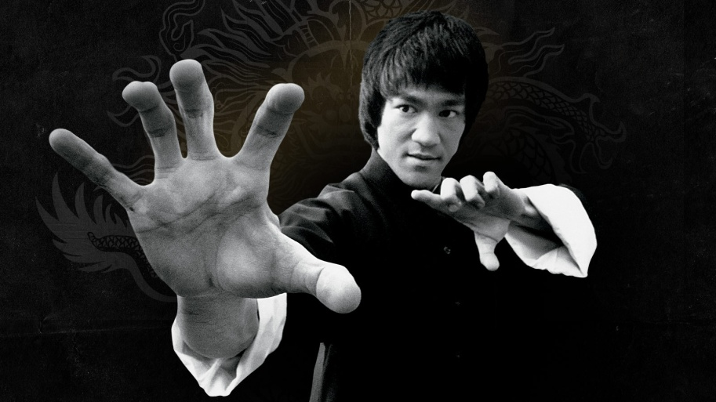
Bell Ringer
What does the quote below mean to you? How can you apply it to school?
“Notice that the stiffest tree is most easily cracked, while the bamboo or willow survives by bending with the wind.”
Bruce Lee

Slide 3
Parts of Speech Pre-Test
This test will cover the basic parts of speech
Nouns, Verbs, Adjectives, Adverbs, Prepositions, Conjunctions, Pronouns.
Answer every question to the best of your ability.
I will use the results of the test to tailor what I teach to best fit the needs of the class.
The rest of the period is yours to complete the test.

Slide 4
Google Classroom – 8-9 Black
Log in to your Chromebook
Click on the Classroom Icon
Click Join Class
Your class code is: wat7mg

Slide 5
Google Classroom – 3-4 Black
Log in to your Chromebook
Click on the Classroom Icon
Click Join Class
Your class code is: z1bdqj

