Slide 1
8th Grade English /Language Arts – Mr. Hopkins
Yesterday Handouts 1. TP-CASTT 2. “Nothing Gold Can Stay” Homework 1. “Nothing Gold Can Stay” Due 1. None | December 18, 2018 (Tuesday) 1. Bell Ringer 2. Check - Wordly Wise Lesson 4 Review 3. Wordly Wise Lesson 4 – Test Review My Email: dhopkins@d88a.org
 | Today’s Homework 1. Wordly Wise Lesson 4 Test - Thursday
Unit 5: Flowers for Algernon
Daily Assignments/Moments | Assessments
Verbals Worksheet – 10pts Participles Worksheet – 5pts Clauses Worksheet – 10pts Wordly Wise Lesson 3 – A-E, Review – 35pts Flowers for Algernon – Pre Reading Questions – 10pts Wordly Wise Lesson 4 – A-E, Review – 35pts | Tell-Tale Heart – Insanity Plea – 100pts Parts of Sentence Test – 37pts Wordly Wise Lesson 3 Test – 40pts Harrison Bergeron Essay – 100pts Works Cited Page – 30pts
All documents and assignments will be loaded onto my class page

Slide 2
Bell Ringer
Vocabulary
Create sentences using the following words:
Despondent
Sage
Entreat
Reverberate
Haunt

Slide 3
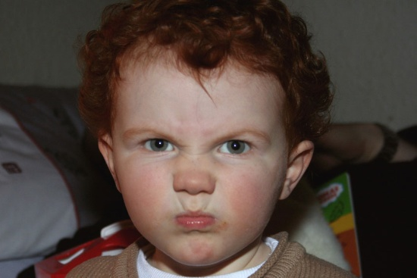
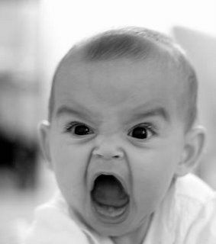
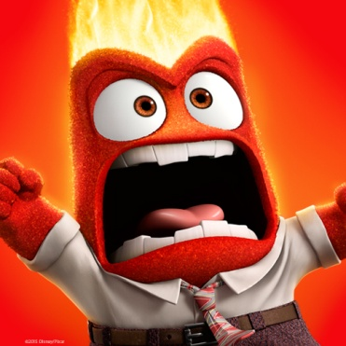
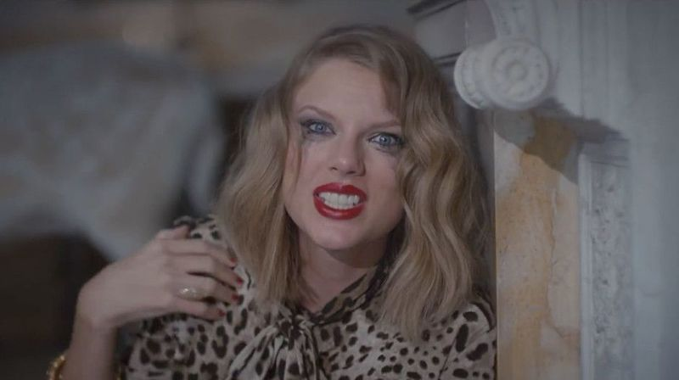
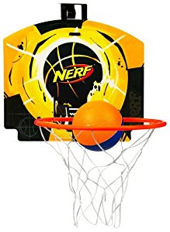
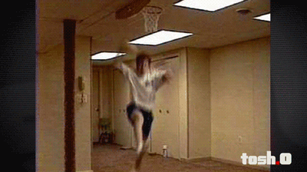
Grudgeball
Wordly Wise Lesson 4 Test Review

Slide 4
Grudgeball Teams
Red Jaguars
Torres, Pianowski, Demenis, Crawford, Salgado, Williams, Siniscalchi
Blue Barracudas
LiCausi, Squires, Adcock, Kowalski, Fakhreddine, Denson, Gomez, Rudman
Green Monkeys
Bocatcat, Spencer, Matusak, Dumbauld, Pierre, Garcia, Mensik
Orange Iguanas
Deubelbeiss, Burek, Sem, Kost, Paradela, Martinez-Liera, Cronin

Slide 5
Grudgeball Teams
Red Jaguars
Palos, Woosley, Trujillo, Matlock, Glover, Ramirez, Bahena
Blue Barracudas
Barlow, Griffins, Jauregui, Henderson, Morgan, McLelland, Velez
Green Monkeys
Patterson, Magallanes, Reid, Vineyard, Parker, Loeza, Hunter
Orange Iguanas
Ruiz, Conner, Casillas, Benavides, Gray, Lopez, Herrera

