Slide 1
8th Grade English /Language Arts – Mr. Hopkins
Friday Handouts 1. None Homework 1. None Due 1. Works Cited Page | December 10, 2018 (Monday) 1. Bell Ringer 2. Flowers for Algernon – Progress Reports 4-8 3. Partner Work – Irony 4. Progress Report #9 My Email: dhopkins@d88a.org
 | Today’s Homework 1. Three Moments
Unit 4: Harrison Bergeron
Daily Assignments/Moments | Assessments
Verbals Worksheet – 10pts Participles Worksheet – 5pts Clauses Worksheet – 10pts Wordly Wise Lesson 3 – A-E, Review – 35pts | Tell-Tale Heart – Insanity Plea – 100pts Parts of Sentence Test – 37pts Wordly Wise Lesson 3 Test – 40pts Works Cited Page – 30pts
All documents and assignments will be loaded onto my class page

Slide 2
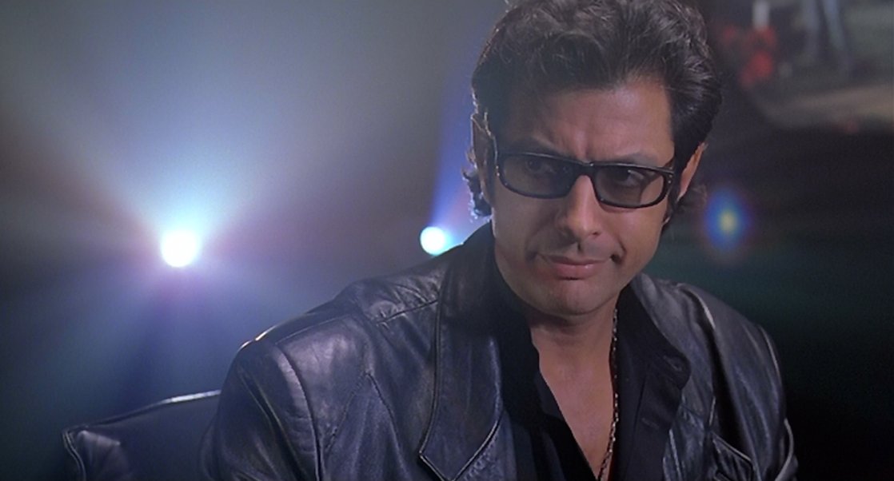
Bell Ringer
Answer the following question in complete sentences.
Just because science can, is it always right?

Slide 4
Progress Reports 4-8
With a partner:
Share your annotations/notes from Reports 4-8
Review Progress Reports 4-8 and look for instances of irony.
Refer to your notes on irony.
Create a list of moments of irony.
Have evidence to support your claim.
When finished, complete three moments based on the Progress Reports 1-8
Use important/revealing moments.

Slide 6
Progress Report 9
With a partner:
Complete your graphic organizer.
Use only Progress Reports 1-9
Cite evidence to support your answers.
Compare and contrast the structure of the text and the author’s words and sentences before and after the surgery.

Slide 7
Progress Report 9 – Whole Class
How have Charlie’s self-realizations affected his attitude and motivation?
Include textual evidence as support.

Slide 8
Progress Report 9 – Independent Work
Answer the following in complete sentences. Cite evidence to support your response.
What is the connection between Charlie and Algernon? What is ironic about Charlie’s feelings toward Algernon?
What do we learn about Charlie through his analysis of Robinson Crusoe?
What is the significance of Charlie’s changing perception of Joe and Frank?
Discuss what Charlie means when he says, “I felt naked.”

