Slide 1
8th Grade English /Language Arts – Mr. Hopkins
Yesterday Handouts 1. None Homework 1. Wordly Wise Lesson 3 – Review Worksheet 2. Read & Annotate - Harrison Bergeron Due 1. None | November 15, 2018 (Thursday) 1. Bell Ringer 2. Wordly Wise Lesson 3 – Review Worksheet - Check 3. Wordly Wise Lesson 3 – Review My Email: dhopkins@d88a.org
 | Today’s Homework 1. Wordly Wise Lesson 3 – Test Monday 2. Essay Rewrite – Due Tomorrow
Unit 4: Harrison Bergeron
Daily Assignments/Moments | Assessments
Verbals Worksheet – 10pts Participles Worksheet – 5pts Clauses Worksheet – 10pts Wordly Wise Lesson 3 – A-E, Review – 35pts | Tell-Tale Heart – Insanity Plea – 100pts Parts of Sentence Test – 37pts
All documents and assignments will be loaded onto my class page

Slide 2
Bell Ringer
Use the following vocabulary words in a sentence.
Extricate
Imperative
Guile
Generation
Encompass

Slide 3
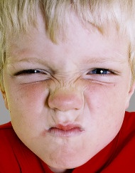
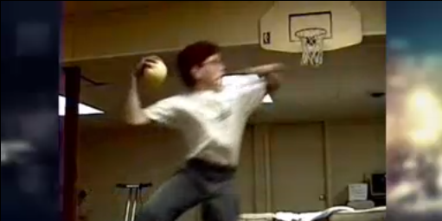
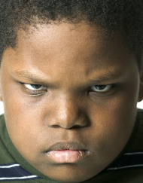
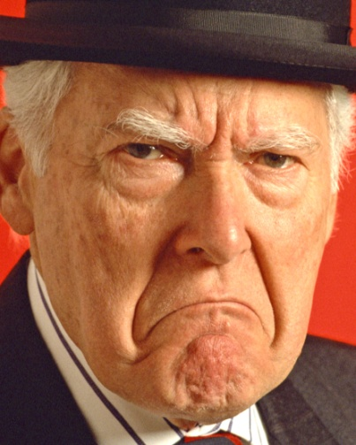
Grudgeball
Wordly Wise Lesson 3 Test Review

Slide 4
Grudgeball Rules
Each group will begin the game with 10 x’s
A player from each team will come up and will be asked a question. Buzz in to answer.
The team that gets the answer correct gets to remove 2 x’s from another team. You can take them both from the same team or split them up.
Before you take away x’s, you will get to increase the number by shooting the Nerf ball into the net. Earn a bonus x from the 1 point line, 2 from the 2 point line, and 3 from downtown.
You can NOT remove x’s from your own team.
If your group is eliminated, you may win your way back in the game by getting an answer correct and shooting a basket. You can earn 2-5 x’s back by answering a question correct and shooting a basket.
The winning team is the one with the most x’s still left at the end of the game!!!!

Slide 5
Grudgeball Teams
Demolition
Garcia, Bocatcat, Cronin, Sem, Pierre, Crawford, Torres, Mensik
The Rockers
Espinoza, Deubelbeiss, Rudman, Adcock, Williams, LiCausi, Matusak, Gomez
The Natural Disasters
Dumbauld, Spencer, Kowalski, Denson, Salgado, Pianowski, Demenis
High Voltage
Kost, Siniscalchi, Burek, Martinez-Lira, Fakhreddine, Paradela, Squires

Slide 6
Grudgeball Teams
Demolition
Matlock, Reid, Griffins, Ruiz, Gray, Ramirez, Casillas, Vineyard
The Rockers
Barlow, McLelland, Lopez, Henderson, Velez, Patterson, Woosley
The Natural Disasters
Magallanes, Jauregui, Trujillo, Parker, Benavides, Conner, Hunter
High Voltage
Glover, Morgan, Bahena, Loeza, Palos, Herrera

