Slide 1
8th Grade English /Language Arts – Mr. Hopkins
Friday Handouts 1. Subject-Predicate Worksheet Homework 1. “Stress for Success” Questions 2. Subject-Predicate Worksheet Due 1. None | October 15, 2018 (Monday) 1. Bell Ringer 2. “Stress for Success” Discussion 3. Moment Sheet Overview 4. The Tell Tale Heart My Email: dhopkins@d88a.org
 | Today’s Homework 1. Subject-Predicate Worksheet
Unit 3: Mood & Tone
Daily Assignments/Moments | Assessments
Parts of Speech Pre-Test – 10pts Parts of Speech Worksheet – 10pts Adjectives/Adverbs Worksheet – 10pts Prepostions/Pronouns Worksheet – 10pts Group Mini Essay – 20pts Worldy Wise Lesson 1 A-E, Review – 35pts Wordly Wise Lesson 2 A-E, Review – 35pts | Summer Reading Assessment – 50pts Parts of Speech Test – 28pts Children’s Book Assessment – 50pts Wordly Wise Lesson 1 Test – 40pts Wordly Wise Lesson 2 Test – 35pts “Thank You, Ma’am” – 30pts
All documents and assignments will be loaded onto my class page

Slide 2
Bell Ringer
This short story has a spooky/scary meaning, can you figure it out?
A few days ago, I was invited to dinner at a friend’s house. The strange thing is, my friend recently got involved in some weird cult. While I was there, he served up some type of meat, but wouldn’t tell me what kind it was. It kind of freaked me out. For a second, I wondered if it was human meat, but then, after I ate it, I knew it definitely wasn’t human meat.

Slide 3
Stress for Success
By: Allison Pierce Stevens

Slide 4
Stress for Success – Questions
In your own words, summarize the central ideas of this article.
In the second paragraph of "Why We Worry," the word "shunted" most closely means...
Which phrase from the text best provides support for your answer to the previous question?
"triggers some major changes"
"then rushes to"
"provides the oxygen and nutrients"
"sustain a fight“

Slide 5
Stress for Success – Questions
Which of the following best states the central idea of the section titled "Why We Worry?“
Fear helped our ancestors avoid attacks by triggering a fight-or-flight response.
When we are afraid or anxious, our bodies go through a series of responses including tense muscles and a faster heartbeat.
While fear can be a useful in protecting us against danger, anxiety is not always helpful.
Anxiety disorders can cause serious health problems.
Which paragraph best supports your answer to the previous question?
Paragraph 6
Paragraph 9
Paragraph 10
Paragraph 11
Which statement best describes how paragraph 13 contributes to the overall article?
It emphasizes that anxiety disorders are not uncommon among young people.
It provides statistics about the percentage of people with anxiety disorders that have above-average intelligence.
It claims that young people who suffer from anxiety are more likely to be successful in life.
It suggests that anxiety disorders affect young people more negatively than adults.

Slide 6
Stress for Success – Questions
In the section titled "Reducing a mountain to a molehill" the author makes the claim that steps can be taken to reduce anxiety. Select the main strategy used in this section to develop this claim.
The author explains a problem and then presents solutions.
The author details the cause and effect of an event or action.
The author shares important events or actions in their order of importance.
The author presents a detailed list of problems.

Slide 7
Stress for Success – Questions
Select three pieces of evidence that support your previous answer.
“People suffering from overwhelming feelings of anxiety have what’s called an anxiety disorder.”
“This broad term [anxiety disorders] includes seven different types.”
“[Kids with anxiety disorders] anticipate the future and work hard toward goals. They also tap into their natural tendency to scan the environment and search for danger, Miller explains.”
“She recommends starting by breathing deeply and relaxing your muscles, group by group.”
“[Deep breathing] allows the brain to clear the neurotransmitters that were released when the body turned on its stress response.”
“Miller also recommends facing fears in small doses.”
“For many students, Sunday night is tough, with a whole new week of school to face the next morning.”

Slide 8
Stress for Success – Questions
9. Record a piece of evidence from the passage that supports the idea that stress is not always harmful.
10. What is the author's main purpose in the article "Stress for Success?"

Slide 9
Stress for Success – Whole Class Discussion
What are some of the causes of stress mentioned in the article? What other events – both dangerous and non-dangerous – cause stress in the daily lives of young people?
What are some situations in which stress or fear could be a positive thing? A negative thing?
Use evidence from this text, your own experience, and other news, literature, art or history in your response.
In the context of this article, how does fear drive action?

Slide 10
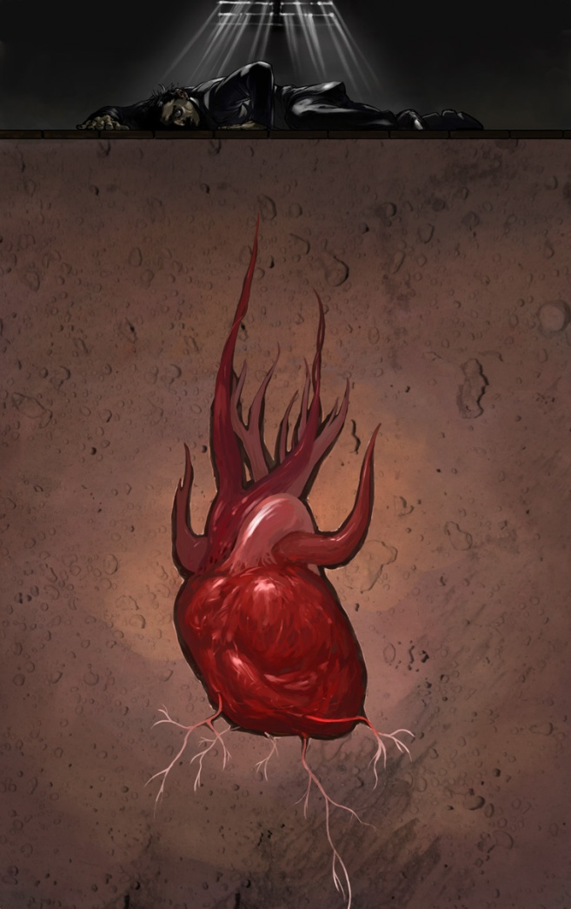
The Tell-Tale Heart
By: Edgar Allan Poe
Page 265

Slide 11
The Tell-Tale Heart
We will read the story together.
Pay attention to how Poe uses mood to setup the story.
Track major plot points/key events.
Pay attention to the narrator.
Is the narrator reliable?
You will need pull 2-3 Moments for the story that you think are critical to analyzing the story.

Slide 12
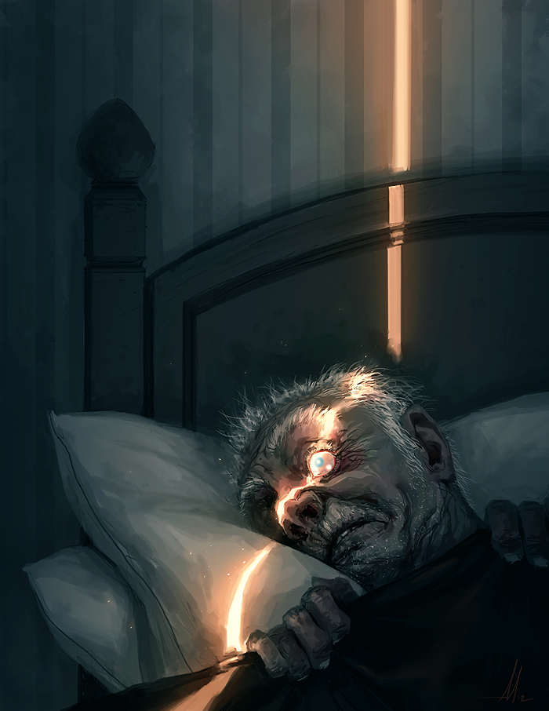

Slide 13
The Tell-Tale Heart
By: Edgar Allan Poe
Page 265

Slide 14
The Tell-Tale Heart - Questions
Why is the narrator defending himself? What does he feel that he is accused of being?
What was it that greatly disturbed the narrator?
What was the narrator’s plan to rid him of the vulture eye?
How did the narrator’s behavior change over the past week before killing the old man?
What did the narrator do every midnight for the past seven days?
Why didn’t the narrator kill the old man during those nights?

Slide 15
The Tell-Tale Heart - Discussion
What is the mood of the story?
Why do you think using first-person point of view is effective in this story?
Describe the narrator’s character. Use direct and indirect characterization.

