Slide 1
8th Grade English /Language Arts – Mr. Hopkins
Yesterday Handouts 1. Subject-Predicate Worksheet Homework 1. Mood and Tone Worksheet 2. Subject-Predicate Worksheet Due 1. None | October 12, 2018 (Friday) 1. Bell Ringer 2. “The Complexity of Fear” - Group Work 3. Fear Discussion 4. “Stress for Success” My Email: dhopkins@d88a.org
 | Today’s Homework 1. “Stress for Success” – Questions 2. Subject-Predicate Worksheet
Unit 3: Mood & Tone
Daily Assignments/Moments | Assessments
Parts of Speech Pre-Test – 10pts Parts of Speech Worksheet – 10pts Adjectives/Adverbs Worksheet – 10pts Prepostions/Pronouns Worksheet – 10pts Group Mini Essay – 20pts Worldy Wise Lesson 1 A-E, Review – 35pts Wordly Wise Lesson 2 A-E, Review – 35pts | Summer Reading Assessment – 50pts Parts of Speech Test – 28pts Children’s Book Assessment – 50pts Wordly Wise Lesson 1 Test – 40pts Wordly Wise Lesson 2 Test – 35pts “Thank You, Ma’am” – 30pts
All documents and assignments will be loaded onto my class page

Slide 2
Bell Ringer
- Brain Teaser

Slide 4
The Complexity of Fear
By: Mary C. Lamia

Slide 5
The Complexity of Fear – Small Group
In a small group (3-4): Discuss the article and share your annotations.
Respond to the following questions:
What is the purpose of the opening lines?
According to paragraph 1, what is true of phobias?
Based on the information in paragraph 2, what is an example of a reaction to fear?
In paragraph 3, what is the main difference between fear and anxiety?
Based on paragraph 3, what is true about fear and anxiety?
According to Lamia, what is fear? Support your answer with evidence.

Slide 6
The Complexity of Fear – Whole Class
Take a couple of minutes to discuss the following with your group, then we will discuss as a whole class.
Is fear a “good” emotion, a “bad” emotion, or both? Explain your answer with examples from your own experience as well as what is presented in the text.

Slide 7
The Complexity of Fear – Exit Slip
On a half sheet of paper:
How has your definition of fear changed from the bell ringer to the end of the period?

Slide 8
Stress for Success
By: Allison Pierce Stevens

Slide 9
Stress for Success– Independently
On your own;
Read and annotate the article.
After each paragraph, ask yourself what the topic of that paragraph was.
Look for evidence supporting that topic.

Slide 10
Stress for Success – Independent Work
Get your Chromebook.
Log in to Google Classroom and go into the first posted assignment.
Read each question carefully. Include evidence from the text for the extended answer questions.
When you’ve answered all your questions individually, DON’T HIT SUBMIT, you can work with a partner to go over the answers.
When finished with your partner, you must submit your Google Form before the end of the period. Make sure you mark your work complete in Classroom.

Slide 11
Stress for Success – Whole Class Discussion
What are some of the causes of stress mentioned in the article? What other events – both dangerous and non-dangerous – cause stress in the daily lives of young people?
What are some situations in which stress or fear could be a positive thing? A negative thing?
Use evidence from this text, your own experience, and other news, literature, art or history in your response.
In the context of this article, how does fear drive action?

Slide 12
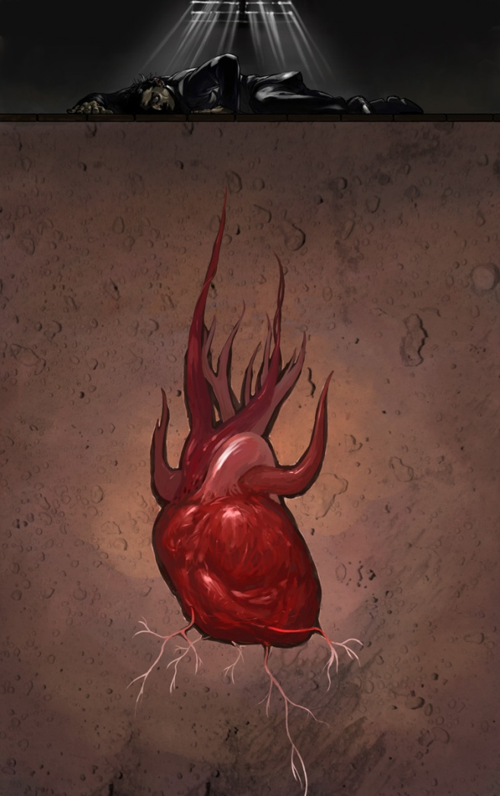
The Tell-Tale Heart
By: Edgar Allan Poe
Page 265

Slide 13
The Tell-Tale Heart
We will read the story together.
Pay attention to how Poe uses mood to setup the story.
Track major plot points/key events.
Pay attention to the narrator.
Is the narrator reliable?
You will need pull 2-3 Moments for the story that you think are critical to analyzing the story.

Slide 14
The Tell-Tale Heart
By: Edgar Allan Poe
Page 265

Slide 15
The Tell-Tale Heart - Questions
Why is the narrator defending himself? What does he feel that he is accused of being?
What was it that greatly disturbed the narrator?
What was the narrator’s plan to rid him of the vulture eye?
How did the narrator’s behavior change over the past week before killing the old man?
What did the narrator do every midnight for the past seven days?
Why didn’t the narrator kill the old man during those nights?

Slide 16
The Tell-Tale Heart - Discussion
What is the mood of the story?
Why do you think using first-person point of view is effective in this story?
Describe the narrator’s character. Use direct and indirect characterization.

