Slide 1
8th Grade English /Language Arts – Mr. Hopkins
Yesterday Handouts 1. None Homework 1. “Thank You Ma’am” Mini Essay Due 1. “Thank You Ma’am” Mini Essay | October 10, 2018 (Wednesday) 1. Bell Ringer 2. Literature Notes – Mood & Tone 3. “The Complexity of Fear” 4. Small Group Work My Email: dhopkins@d88a.org
 | Today’s Homework 1. Mood and Tone Worksheet
Unit 3: Mood & Tone
Daily Assignments/Moments | Assessments
Parts of Speech Pre-Test – 10pts Parts of Speech Worksheet – 10pts Adjectives/Adverbs Worksheet – 10pts Prepostions/Pronouns Worksheet – 10pts Group Mini Essay – 20pts Worldy Wise Lesson 1 A-E, Review – 35pts Wordly Wise Lesson 2 A-E, Review – 35pts | Summer Reading Assessment – 50pts Parts of Speech Test – 28pts Children’s Book Assessment – 50pts Wordly Wise Lesson 1 Test – 40pts
All documents and assignments will be loaded onto my class page

Slide 2
Bell Ringer
Respond to the following quote. Explain what it means, then answer the follow up question.
“There is no passion so contagious as that of fear.”
Michel de Montaigne
What is fear?

Slide 3
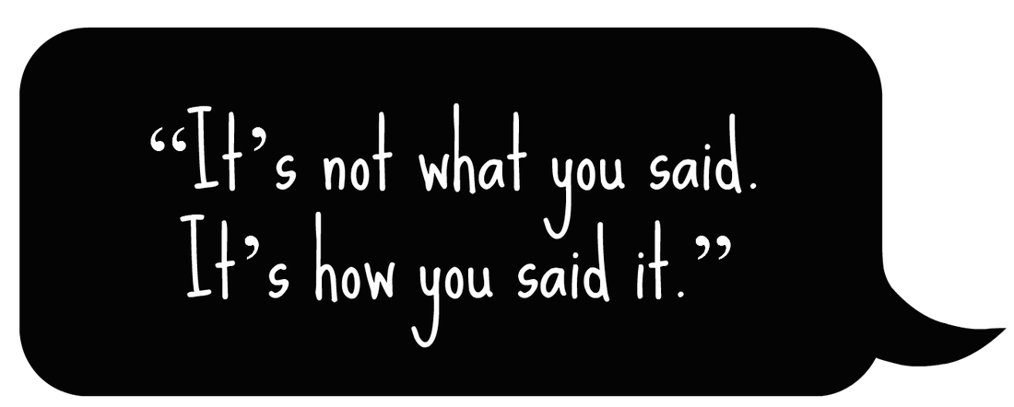
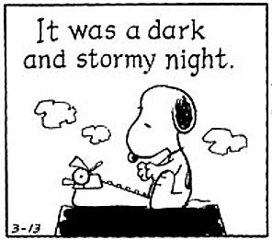
Mood and Tone
Literature Notes

Slide 4
Overview
In order to make a story more interesting, writers use tools called Mood and Tone to express ideas and create feeling in their readers.
Word choice, style, and details help convey their tone and create a mood, or feelings, for the reader.

Slide 5
One Movie, Two Moods
We are going to watch two movie trailers.
Take note of the differences between them.
How do the trailers convey different moods?
How does the first video create a positive tone and a warm, happy mood?
How does the second trailer create a negative mood and an uneasy or frightening mood?
Notes:
https://www.youtube.com/watch?v=TbQm5doF_Uc - Regular Version
https://www.youtube.com/watch?v=y4Mvqioxw88 - Recut

Slide 6
Mood
The mood of a text is how the reader feels after reading it.
The details that the author uses can help create the mood.
The word choice employed by the author also helps create a mood.

Slide 7
Tone
The tone of a text tells you how the author feels about the subject.
What is his/her attitude about the subject?
Tone can be understood by looking for positive or negative language used by the author.
The tone of a text can be positive, negative, or even neutral.

Slide 8
Tone
Identifying tone is all about knowing the definitions/synonyms for many descriptive vocabulary words.
Without this large vocabulary, it is difficult to describe tone outside of “good” or “bad.”

Slide 9
Examples
Bitter
Serious
Witty
Playful
Tender
Sympathetic
Optimistic
Fearful
Impartial
Cheerful
Amusing
Angry
Detached
Gentle
Sincere
Compassionate
Humorous
Afraid

Slide 10
The Complexity of Fear
By: Mary C. Lamia

Slide 11
The Complexity of Fear – Independently
On your own;
Read and annotate the article.
After each paragraph, ask yourself what the topic of that paragraph was.
Look for evidence supporting that topic.
After you’re finished reading and annotating, make an outline for the article on the back of the handout.

Slide 12
The Complexity of Fear – Small Group
In a small group (3-4): Discuss the article and share your annotations.
Respond to the following questions:
What is the purpose of the opening lines?
According to paragraph 1, what is true of phobias?
Based on the information in paragraph 2, what is an example of a reaction to fear?
In paragraph 3, what is the main difference between fear and anxiety?
Based on paragraph 3, what is true about fear and anxiety?
According to Lamia, what is fear? Support your answer with evidence.

Slide 13
The Complexity of Fear – Whole Class
Take a couple of minutes to discuss the following with your group, then we will discuss as a whole class.
Is fear a “good” emotion, a “bad” emotion, or both? Explain your answer with examples from your own experience as well as what is presented in the text.

Slide 14
The Complexity of Fear – Exit Slip
On a half sheet of paper:
How has your definition of fear changed from the bell ringer to the end of the period?

